Slide 1
Student LMS Portal Gamification
Group Members:
Mani Chegu
Sujith Kumar
Sugam
Ravi Teja

Slide 2
1. Problem Statement
In the evolving landscape of education, the conventional Learning Management Systems (LMS) often lack the engagement required to motivate students and provide a personalized learning experience.
Our challenge is to Design and implement a gamified learning management system (LMS) portal for students. The solution should incorporate points, badges, leaderboards, and other interactive elements to motivate students, track progress, and make learning more engaging.
Develop personalized learning paths based on individual student performance and learning styles.

Slide 3
2. Objectives
Implement Gamification Elements
User Friendly Interface
Integrate points, badges, and leaderboards into the LMS to create a gamified experience.
Develop a user-friendly interface or application that enables users to easily interact and navigate.
Facilitate Instructor Engagement
Ensure Security & Privacy
Include features that allow instructors to monitor student progress and engagement.
Implement robust security measures to protect student data and privacy.

Slide 4
3. Tech Stack: MERN Stack
Express.js
MongoDB
Minimalist yet powerful Node.js framework for building robust and scalable server-side applications based on Node.js
Known for its flexibility, scalability, and ease of handling diverse, unstructured data, making it an ideal choice .
React.js
Node.js
Provides a declarative and efficient way to build user interfaces, making it easy to create interactive and dynamic web applications.
Enables efficient server-side JavaScript execution, providing a lightweight and scalable platform for building fast, real-time, and networked applications.

Slide 5
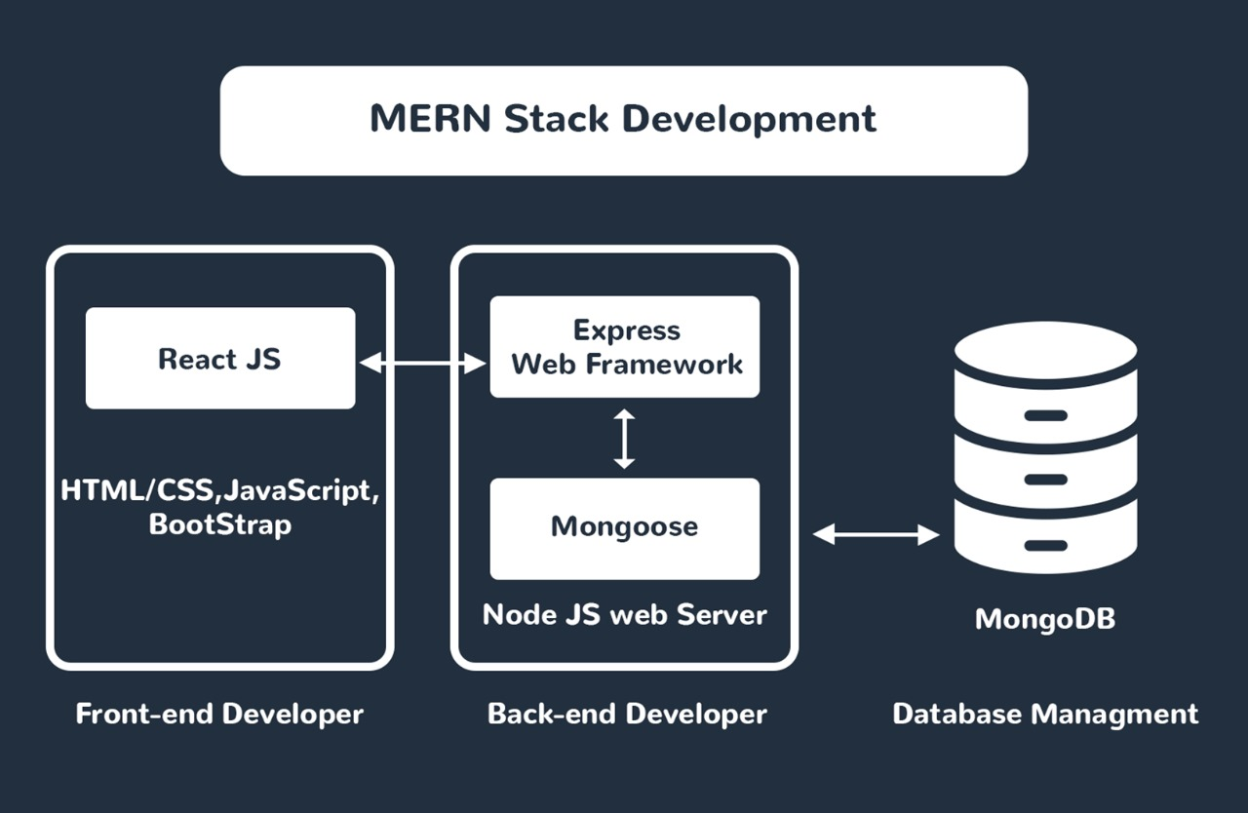
4. System Architecture

Slide 6
5. Approach & Solution
Student Login:
Home page
Courses & Progress.
Attendance
Leaderboard
View standings and badges.
Feedback
Challenges ( To get extra points )
Personalised Learning
Give Learning path based on the student performance .
Query box to answer the student Queries.
Teacher Login:
Home page
Student Details.
Search for student details.
CRUD operations on courses.
Create & post challenges.
Mark student attendance.
Admin Login:
Add new students and teachers

Slide 7

Thank You!

